Slide 1
CMSC204
Kartchner
V(StateGraph) = {Oregon, Alaska, Texas, Hawaii, Vermont, NewYork, California}
E(StateGraph) = {(Alaska, Oregon), (Hawaii, Alaska), (Hawaii, Texas), (Texas, Hawaii), (Hawaii, California), (Hawaii, New York), (Texas, Vermont), (Vermont, California), (Vermont, Alaska)}
1. Draw the StateGraph
A = Alaska, C = California, H = Hawaii, N = New York, O = Oregon, T = Texas, V = Vermont

Slide 2
a. Show the adjacency matrix that would describe the edges in the graph. Store the vertices in alphabetical order
A | C | H | N | O | T | V
- | 0 | 0 | 0 | 1 | 0 | 0
0 | - | 0 | 0 | 0 | 0 | 0
1 | 1 | - | 1 | 0 | 1 | 0
0 | 0 | 0 | - | 0 | 0 | 0
0 | 0 | 0 | 0 | - | 0 | 0
0 | 0 | 1 | 0 | 0 | - | 1
1 | 1 | 0 | 0 | 0 | 0 | -
States
A
C
H
N
O
T
V
3. b. Show the adjacency lists
that would describe the edges in the graph
A
C
H
N
O
T
V
O
A, C, N, T
H, V
A, C

Slide 3
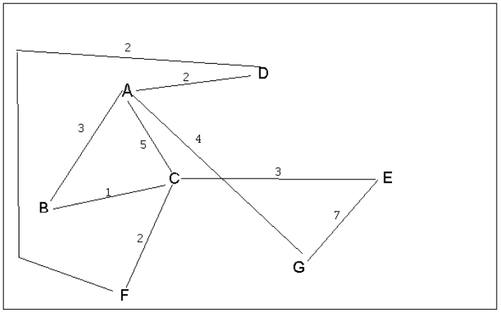
4 a. Which of the following lists the graph nodes in depth first order beginning with E?
A) E, G, F, C, D, B, A
B) G, A, E, C, B, F, D
C) E, G, A, D, F, C, B
D) E, C, F, B, A, D, G
4 b. Which of the following lists the graph nodes in breadth first order beginning at F?
A) F, C, D, A, B, E, G
B) F, D, C, A, B, C, G
C) F, C, D, B, G, A, E
D) a, b, and c are all breadth first traversals

Slide 4
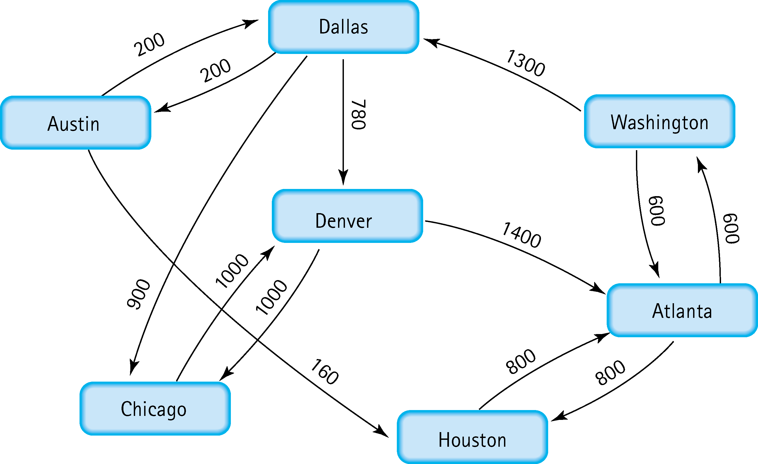
5. Find the shortest distance from Atlanta to every other city
Atlanta to Houston: Atlanta -> Houston. Total Cost: 800
Atlanta to Washington: Atlanta -> Washington. Total Cost: 600
Atlanta to Dallas: Atlanta -> Washington -> Dallas. Total Cost: 1900
Atlanta to Austin: Atlanta -> Washington -> Dallas -> Austin. Total Cost: 2100
Atlanta to Denver: Atlanta -> Washington -> Dallas -> Denver. Total Cost: 2680
Atlanta to Chicago: Atlanta -> Washington -> Dallas -> Chicago. Total Cost: 2800

Slide 5
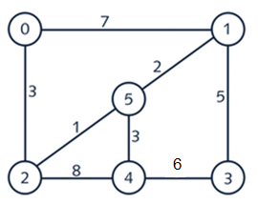
6. Find the minimal spanning tree using Prim’s algorithm. Use
0 as the source vertex . Show the steps.
Starting at 0. Compare edge costs of vertex 0. The edge connects that vertexes 0 to 2 cost the least. Add Vertex 2 to set {0, 2}. Compare edge costs of vertexes 0 and 2. The edge connects that vertexes 2 to 5 cost the least. Add Vertex 5 to set {0, 2, 5}. Compare edge costs of vertexes 0, 2, and 5. The edge connects that vertexes 5 to 1 cost the least. Add Vertex 1 to set {0, 2, 5, 1}. Compare edge costs of vertexes 0, 2, 5, and 1. The edge connects that vertexes 5 to 4 cost the least. Add Vertex 4 to set {0, 2, 5, 1, 4}. Compare edge costs of vertexes 0, 2, 5, 1, and 4. The edge connects that vertexes 1 to 3 cost the least. Add Vertex 3 to set {0, 2, 5, 1, 4, 3}. All vertexes are in the set. Finished.

Slide 6
7. Find the minimal spanning tree using Kruskal’s algorithm.
Show the weights in order and the steps.
Find the edge that cost the least. So, the edge connecting vertexes 2 and 5. Add vertexes 2 and 5 {2, 5}. Find the next edge that cost the least. So, the edge connecting vertexes 5 and 1. Add vertex 1 since 5 is already in the set {2, 5, 1}. Find the next edge that cost the least. So, the edge connecting vertexes 5 and 4. Add vertex 4 since 5 is already in the set {2, 5, 1, 4}. Find the next edge that cost the least. So, the edge connecting vertexes 2 and 0. Add vertex 0 since 2 is already in the set {2, 5, 1, 4, 0}. Find the next edge that cost the least. So, the edge connecting vertexes 1 and 3. Add vertex 3 since 1 is already in the set {2, 5, 1, 4, 0, 1}. All vertexes are in the set. Finished.

Slide 7
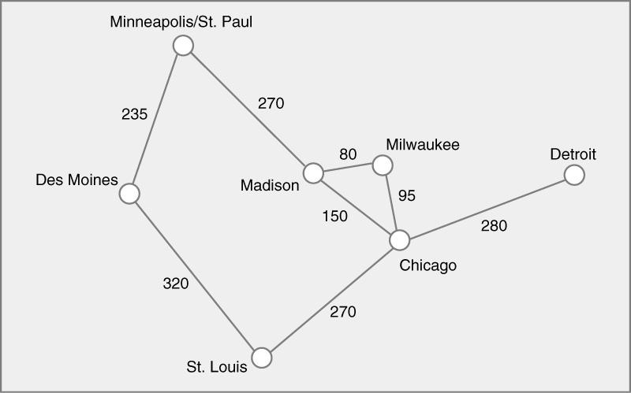
8. Find the minimal spanning tree using the algorithm you prefer. Use
Minneapolis/St. Paul as the source vertex
{(Minneapolis/St. Paul, Des Moines), (Minneapolis/St. Paul, Madison), (Madison, Milwaukee), (Milwaukee, Chicago), (Chicago, St. Louis), (Chicago, Detroit)}

Slide 8
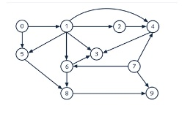
9. List the nodes of the graph in a breadth first topological ordering. Show the
steps using arrays predCount, topologicalOrder and a queue
predCount array: {0, 1, 1, 3, 3, 2, 2, 0, 2, 2} Queue vertexes with 0 predCount. So, vertexes 0 and 7. Queue: [0, 7]. Add vertex 0 to order and update its neighbors. topologicalOrder: [0] predCount array: {0, 0, 1, 3, 3, 1, 2, 0, 2, 2}. Queue vertexes with 0 predCount. So, vertex 1 since 7 is in queue and 0 has been processed. Queue: [7, 1]. Add vertex 7 to order and update its neighbors. topologicalOrder: [0, 7] predCount array: {0, 0, 1, 3, 2, 1, 1, 0, 2, 1}. No new vertex has 0 predCount. Queue: [1]. Add vertex 1 to order and update its neighbors. topologicalOrder: [0, 7, 1] predCount array: {0, 0, 0, 1, 1, 0, 0, 0, 2, 1}. Queue vertexes with 0 predCount. So, vertexes 2, 5, 6. Queue: [2, 5, 6]. Add vertex 2 to order and update its neighbors. topologicalOrder: [0, 7, 1, 2] predCount array: {0, 0, 0, 1, 0, 0, 0, 0, 2, 1}. Queue vertexes with 0 predCount. So, vertex 4. Queue: [5, 6, 4]. Add vertex 5 to order and update its neighbors. topologicalOrder: [0, 7, 1, 2, 5] predCount array: {0, 0, 0, 1, 0, 0, 0, 0, 1, 1}. No new vertex has 0 predCount. Queue: [6, 4]. Add vertex 6 to order and update its neighbors. topologicalOrder: [0, 7, 1, 2, 5, 6] predCount array: {0, 0, 0, 0, 0, 0, 0, 0, 0, 1}. Queue vertexes with 0 predCount. So, vertexes 3 and 8. Queue: [4, 3, 8]. Add vertex 4 to order and update its neighbors. topologicalOrder: [0, 7, 1, 2, 5, 6, 4] predCount array: {0, 0, 0, 0, 0, 0, 0, 0, 0, 1}. No new vertex has 0 predCount. Queue: [3, 8]. Add vertex 3 to order and update its neighbors. topologicalOrder: [0, 7, 1, 2, 5, 6, 4, 3] predCount array: {0, 0, 0, 0, 0, 0, 0, 0, 0, 1}. No new vertex has 0 predCount. Queue: [8]. Add vertex 8 to order and update its neighbors. topologicalOrder: [0, 7, 1, 2, 5, 6, 4, 3, 8] predCount array: {0, 0, 0, 0, 0, 0, 0, 0, 0, 0}. Queue vertexes with 0 predCount. So, vertex9. Queue: [9]. Add vertex 9 to order. topologicalOrder: [0, 7, 1, 2, 5, 6, 4, 3, 8, 9].

Slide 9
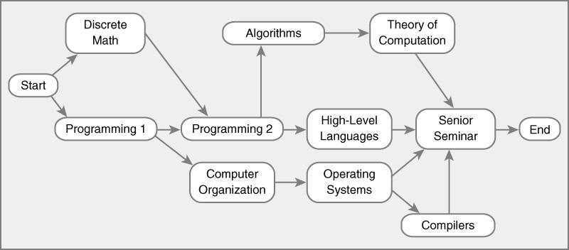
10. List the nodes of the graph in a breadth first topological ordering.
Discrete Math, Programming 1, Programming 2, Computer Organization, Algorithms, High-Level Languages, Operating Systems, Theory of Computation, Senior Seminar, Compilers

